Slide 1
Google Analytics Customer Revenue Prediction
-- Yu Liu

Slide 2
Questions
This project will analyze a Google Merchandise Store (also known as GStore, where Google swag is sold) customer dataset to predict how much each customer will spend money on Gstore from December 1st, 2018 to January 31st, 2019.
In real word, the 80/20 rule has proven true for many businesses–only a small percentage of customers produce most of the revenue. So it is difficult for marketing teams to make appropriate investments in promotional strategies.
Online store analysis can educate the types of products customers like, customers distribution and many other useful factors. This can help make more educated decisions when it comes to product creation or curation for stores.

Slide 3
Data Collection
This project is a Kaggle competition, Google Analytics Customer Revenue Prediction.
The train data set collects view information of every Gstore customers and their cost from August 1st, 2016 to May 1st, 2018.
The test data set collects view information of every Gstore customers from December 1st, 2018 to January 31st, 2019, and the target is to predict how much they will spend on GStore during this period.

Slide 4
Main Features
fullVisitorId- A unique identifier for each user of the Google Merchandise Store.
channelGrouping - The channel via which the user came to the Store.
date - The date on which the user visited the Store.
device - The specifications for the device used to access the Store.
geoNetwork - This section contains information about the geography of the user.
socialEngagementType - Engagement type, either "Socially Engaged" or "Not Socially Engaged".
totals - This section contains aggregate values across the session.
trafficSource - This section contains information about the Traffic Source from which the session originated.
visitId - An identifier for this session. This is part of the value usually stored as the _utmb cookie. This is only unique to the user. For a completely unique ID, you should use a combination of fullVisitorId and visitId.
visitNumber - The session number for this user. If this is the first session, then this is set to 1.
visitStartTime - The timestamp (expressed as POSIX time).
hits - This row and nested fields are populated for any and all types of hits. Provides a record of all page visits.
customDimensions - This section contains any user-level or session-level custom dimensions that are set for a session. This is a repeated field and has an entry for each dimension that is set.
totals - This set of columns mostly includes high-level aggregate data.

Slide 5

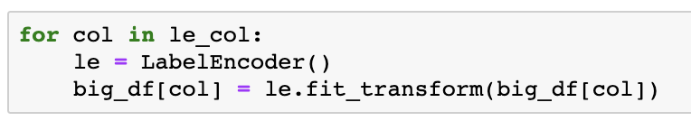
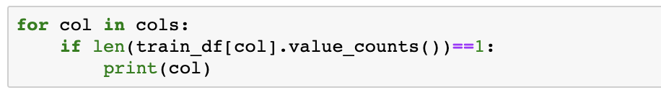
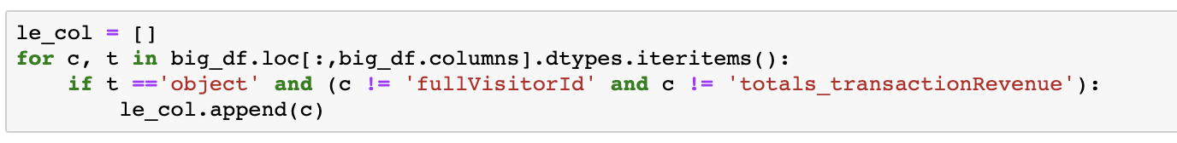
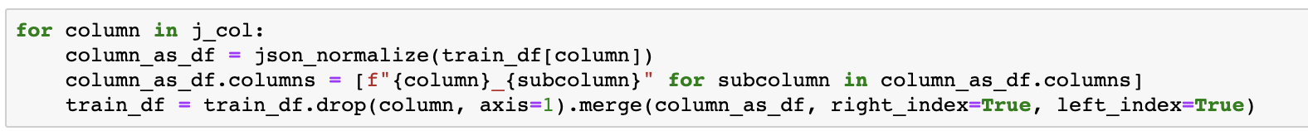

Data Munging
Change POSIX timestamp to readable time.
Handle json columns.
Drop columns with consistent values.
Drop columns with duplicate information.
Fill NaN values.
Change columns’ type.
Label encoding.

Slide 6
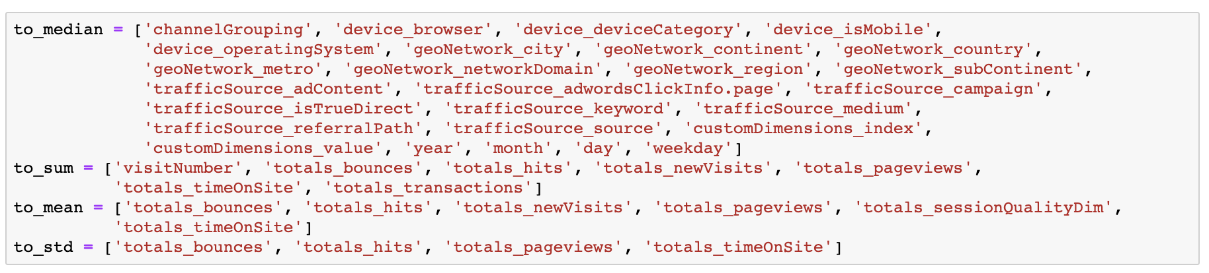
Data Munging
The target is to predict every customer revenue in the Gstore, and row in the datasets is the record of every view of every customer. So we should combine all views belong to same customer (same fullVisitorId).
When merge rows with same fullVisitorId, we need to decide what to do with columns. I use some diferent ways to different columns to get better result.
Like channelGrouping and device_browser columns, get their median value is enough, and for totals_bounces and some other columns I get their sum, mean and standard decitation.

Slide 7
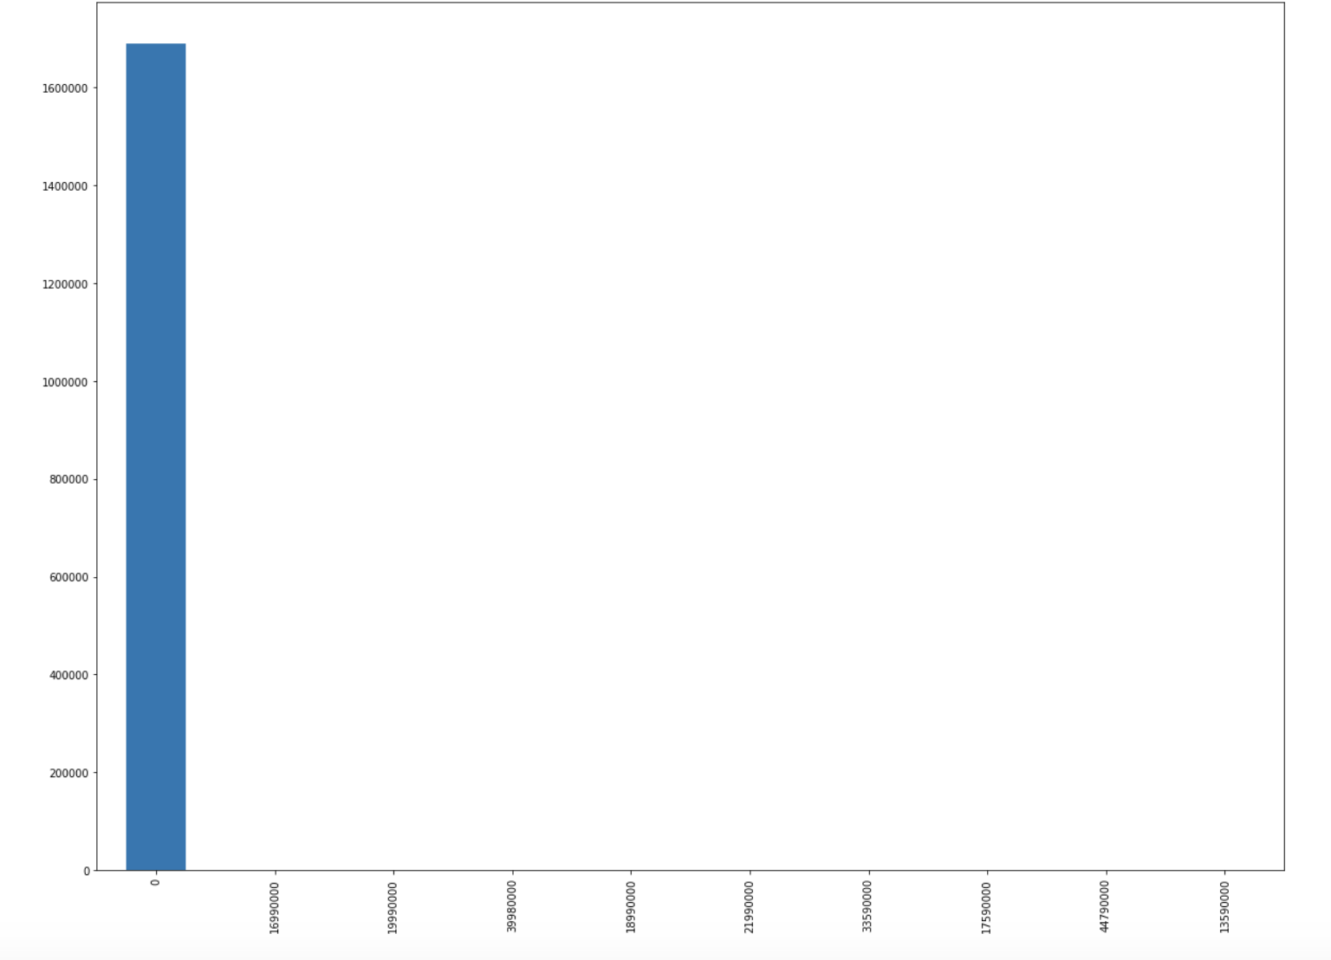
Main visualization
Target Value
The histogram plot of top 10 values, as we see 0 is such much, and we can't see other 9 values.
As Kaggle's Overview said, "The 80/20 rule has proven true for many businesses–only a small percentage of customers produce most of the revenue", the percentage of customers produce most of the revenue is really low.

Slide 8
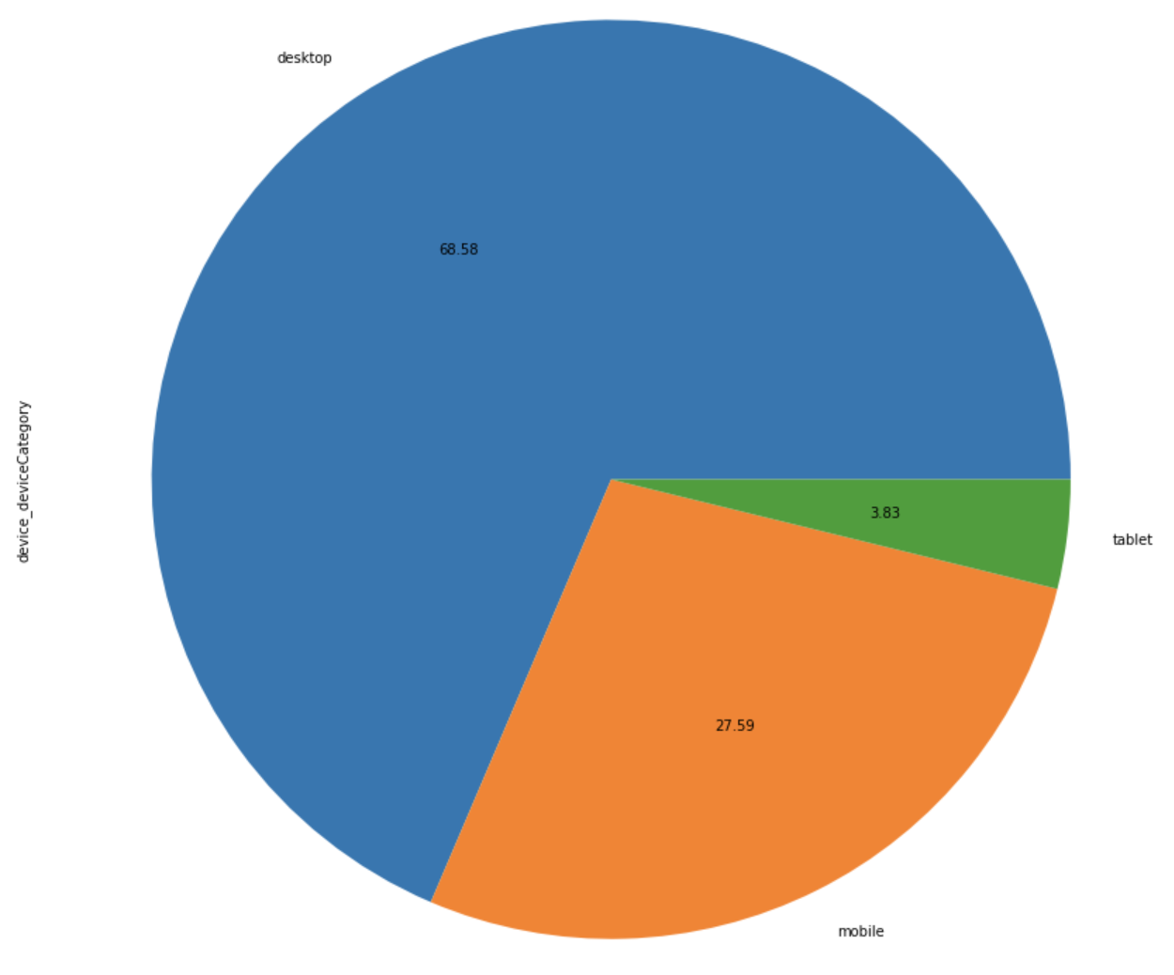
Main visualization
Device category
From device_deviceCategory column, we can see 68.58% devices are desktop, 27.59% are mobile, and 3.83% are tablet. As this dataset is from 2016-08-01 to 2018-05-01, the result may be different now.

Slide 9
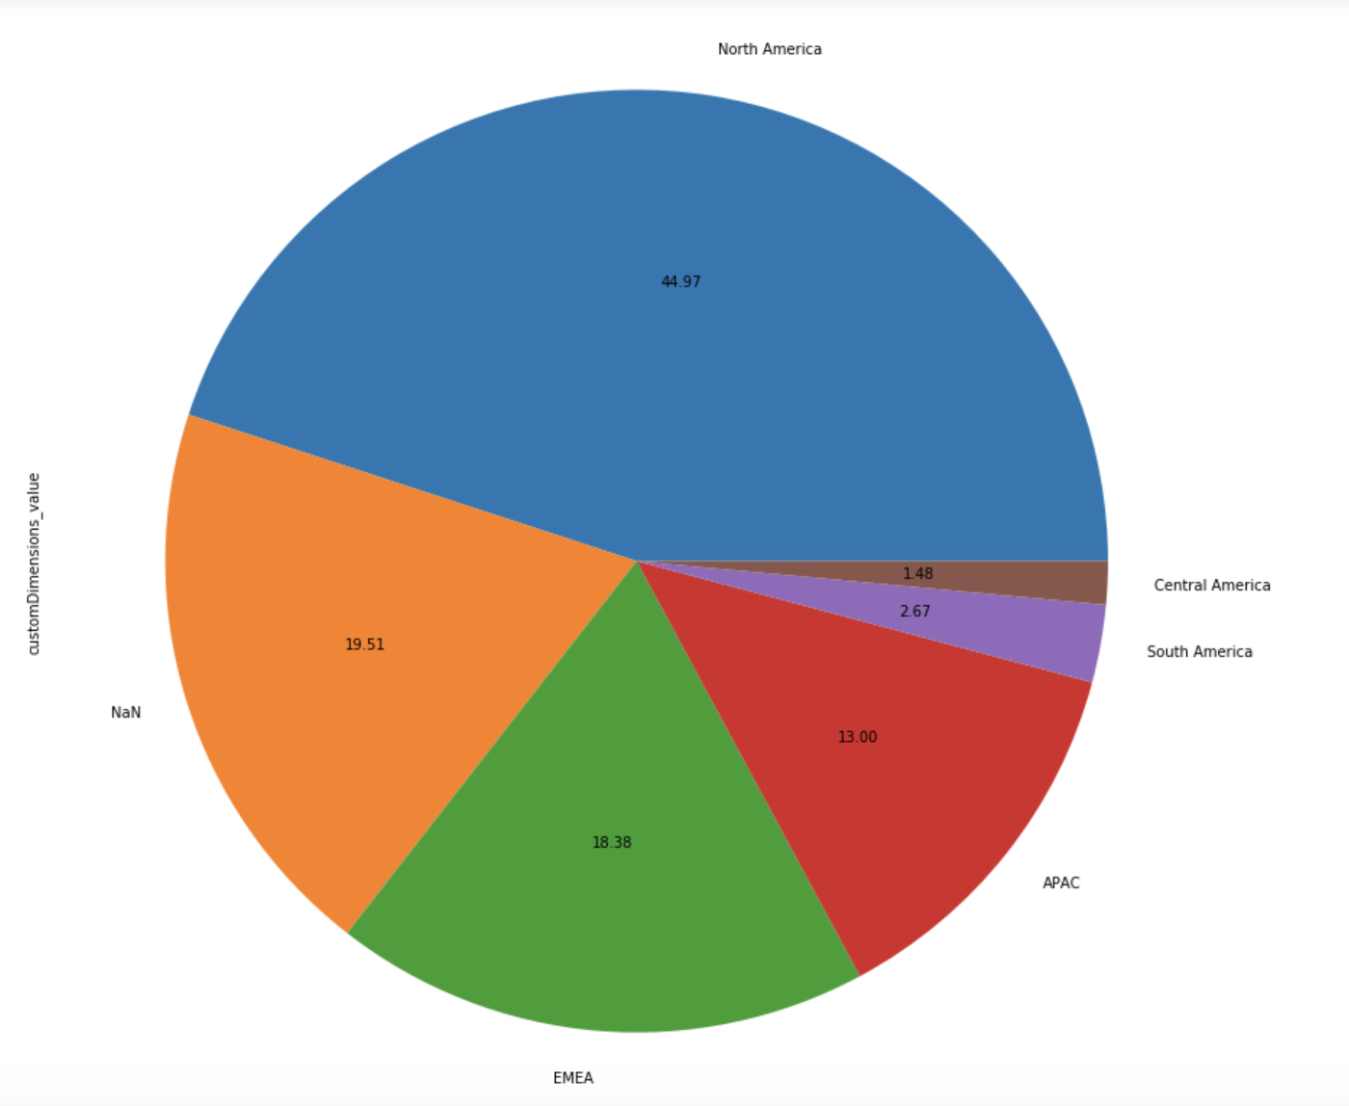
Main visualization
Customer Dimensions
We can see 44.97% GStore customers are from North America.

Slide 10
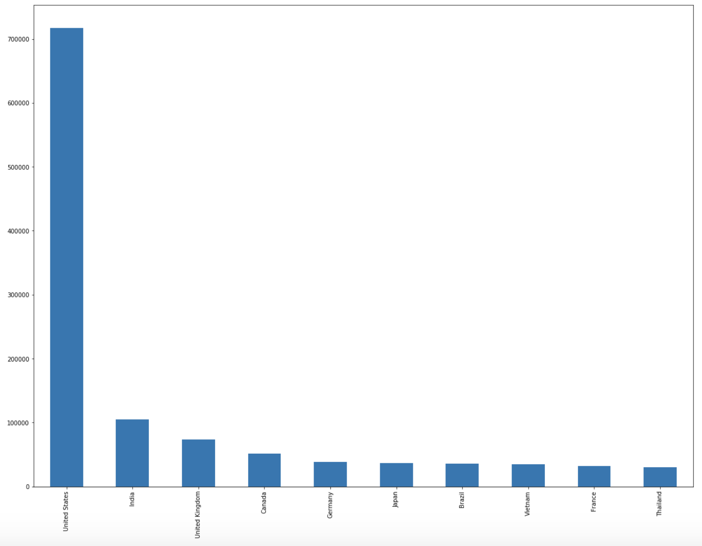
Main visualization
GeoNetwork
In the histogram of top 10 country, we can see mainly customers are in United States, and the second country is India.

Slide 11
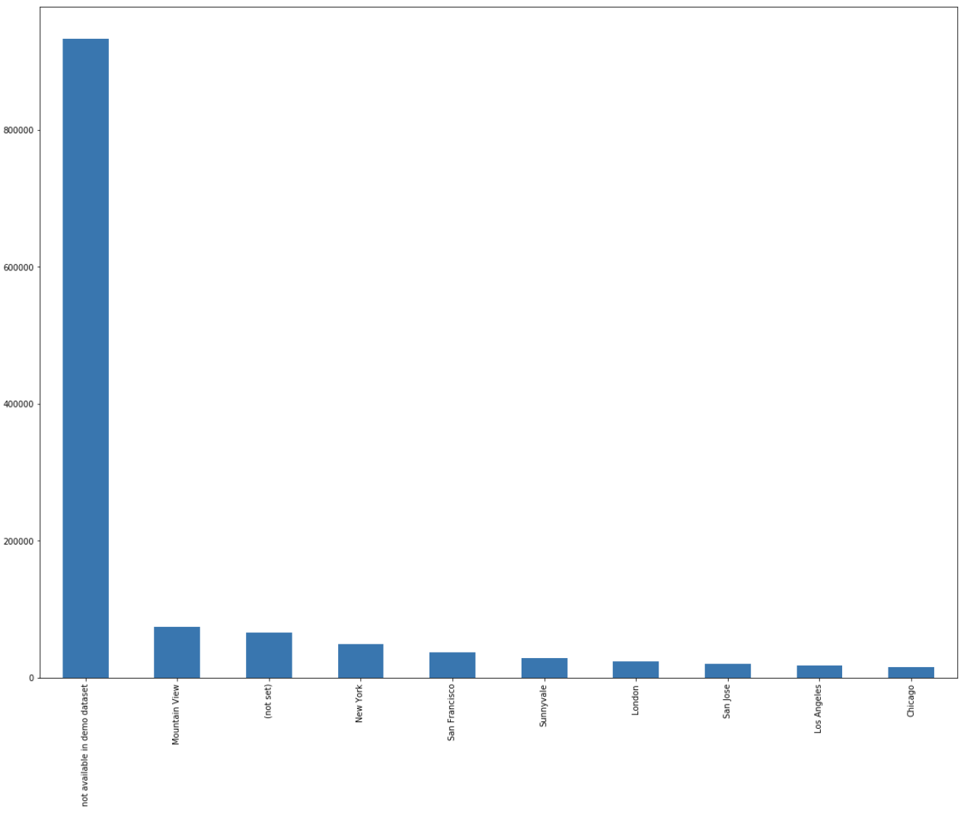
Main visualization
GeoNetwork
In the histogram of top 10 city, nearly 90%90% data are not allowed to see or not set, and except these data, top 1 city is Mountain View, followed by New York and San Francisco.
In city columns, nearly 90% data are not allowed to see or not set, and this data set not provide longitude and latitude because of customers’ privacy, if we can get more information, I think the prediction will be better.

Slide 12
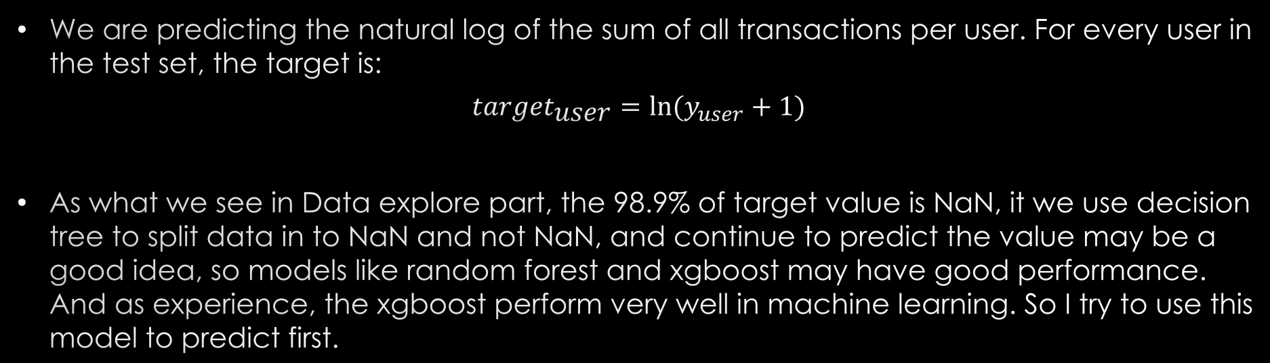
Prediction
We are predicting the natural log of the sum of all transactions per user. For every user in the test set, the target is:
$${\text{target}}_{\text{user}}=\ln{(y_{user}+1)}$$
As what we see in Data explore part, the 98.9% of target value is NaN, it we use decision tree to split data in to NaN and not NaN, and continue to predict the value may be a good idea, so models like random forest and xgboost may have good performance. And as experience, the xgboost perform very well in machine learning. So I try to use this model to predict first.

Slide 13
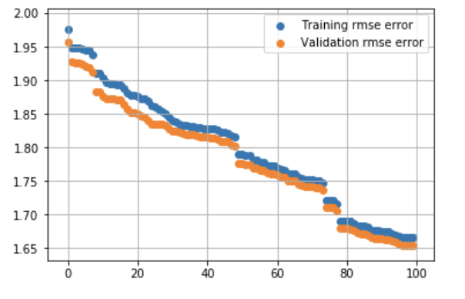
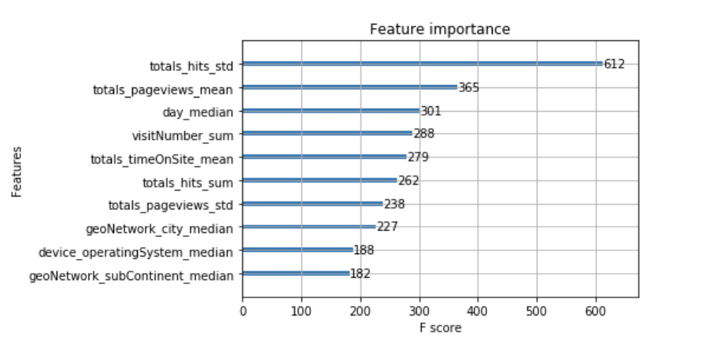
Prediction
From the the root-mean-square-error plot we can see, as the iteration increase, both Training rmse and Validation rmse are becoming smaller, and Training rmse is getting colser to Validation rmse, but with iteration increase further, may overfitting, so I choose the number of iteration is 100.
From the feature importance plot, we can see the totals_hits feature is most important, which means the number of total hits this customer hit in Gstore. The second important feature is totals_pageviews, which means how many pages this customer view in Gstore. The day of month is third important, which seems that the day of month the customer view Gstore may realted to the customer' revenue. And the customers' geograph is also important.

Slide 14
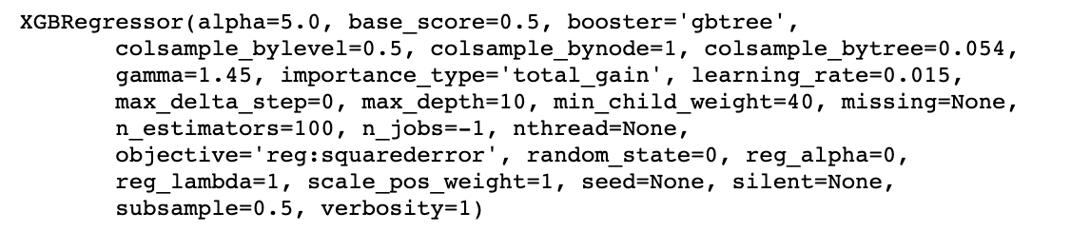
Prediction
I tried to use GridSearchCV to tune parameters, but because the data set is too large and the power of my laptop is not good enough, the auto tuning process will take much time, so I only manual tuned parameters, and after several times, I got the bset score in Kaggle is 1.00834, and the rank of it is about 400.

Slide 15
Conclusion
I also tried some other models, but their result are not better than xgboost.
As I don't use the hits columns, and I discard some columns look like useless (truth may be not), the prediction result is not good enough. The methods I group the same ID can also be improved to get a better result.
I think the score I get can be further improved, if I continue tune parameters or with better data mining process, but the cost is time. It's a pity that I don't have more time to continue, hope I can review this project in the future.

